Slide 1
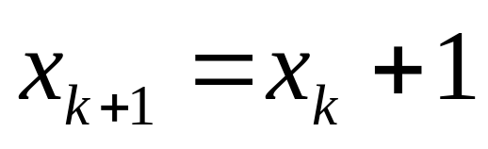
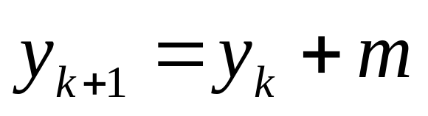
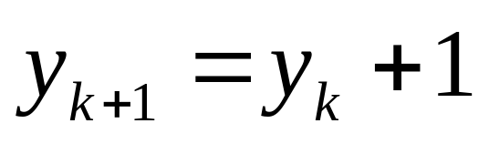
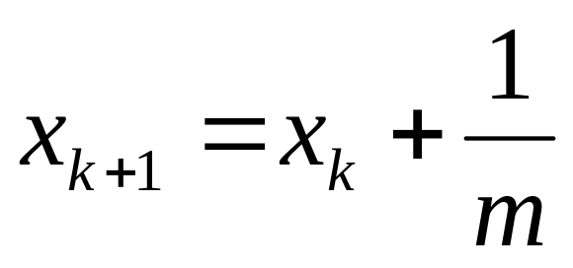
The DDA Algorithm (cont…)
If -1<m<1 then
Then roundoff y.
Otherwise,
Then roundoff x.

Slide 2
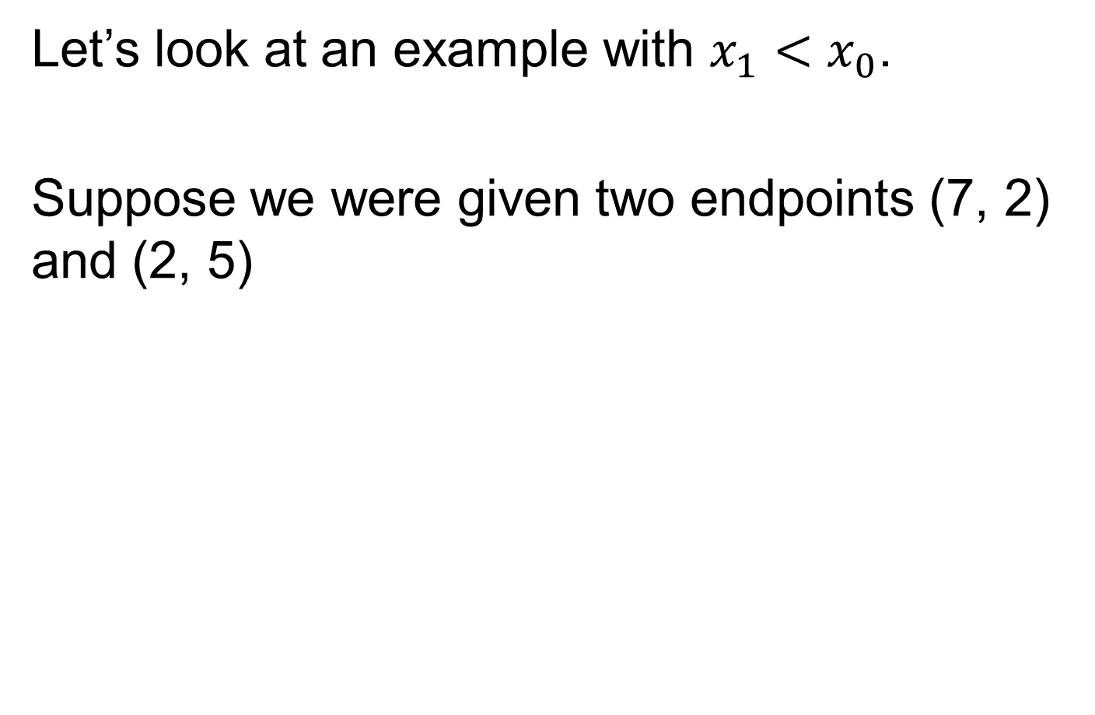
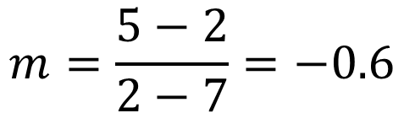

Slide 3

DDA Algorithm Example
y
x(+1) | y(+m) | y(roundoff) | pixel
7 | 2
8 | 1.4 | 1 | (8, 1)
9 | 0.8 | 1 | (9, 1)
(2, 5)
5
2
(7, 2)
2
7
x

Slide 4
(8, 1), (9, 1) these points are outside the line segment, so unacceptable.
So, we must decrement here. So we need to update our DDA algorithm for these cases.

Slide 5
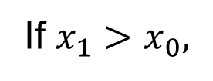
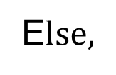




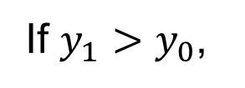
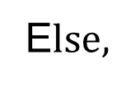


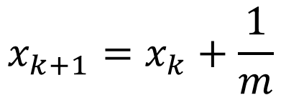
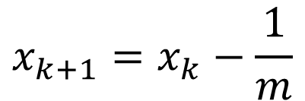
The DDA Algorithm revised
If -1<m<1 then
Then roundoff y.
Otherwise, if -∞<m<-1 or 1<m< ∞ then,
Then roundoff x.

Slide 6
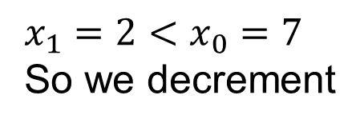
DDA Algorithm Example
First endpoint: (7, 2)
Second endpoint: (2, 5)
y
x(-1) | y(-m) | y(roundoff) | pixel
7 | 2
6 | 2.6 | 3 | (6, 3)
5 | 3.2 | 3 | (5, 3)
4 | 3.8 | 4 | (4, 4)
3 | 4.4 | 4 | (3, 4)
(2, 5)
5
2
(7, 2)
2
7
x

Slide 7
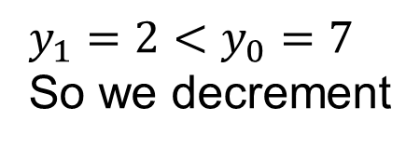


DDA Algorithm Example
First endpoint: (2, 7)
Second endpoint: (5, 2)
y
(2, 7)
y(-1) | x(-1/m) | x(roundoff) | pixel
7 | 2
6 | 2.6 | 3 | (3, 6)
5 | 3.2 | 3 | (3, 5)
4 | 3.8 | 4 | (4, 4)
3 | 4.4 | 4 | (4, 3)
7
2
(5, 2)
2
5
x

Slide 8
Order of 1st and 2nd endpoints make a difference in which case of DDA will be applied. Output will still remain same.

